Slide 1
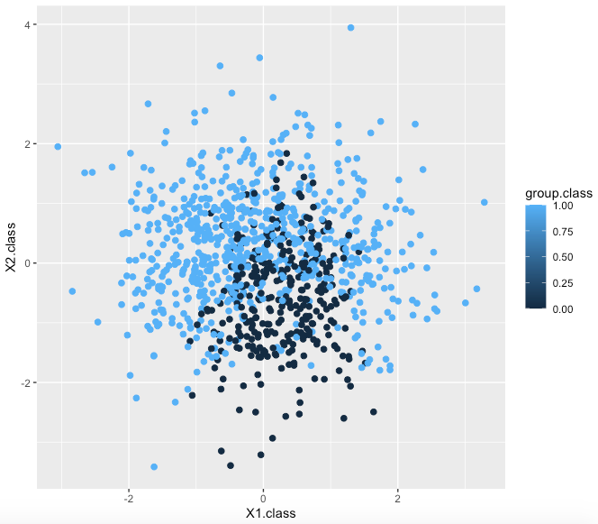
Classification methods to approximate Bayes classifier
Nicholas P.J. Harper, 700038738
Problem:
Find the best method to classify a dataset of X1 and X2 data and report on the results from each method and the optimization techniques employed

Slide 2
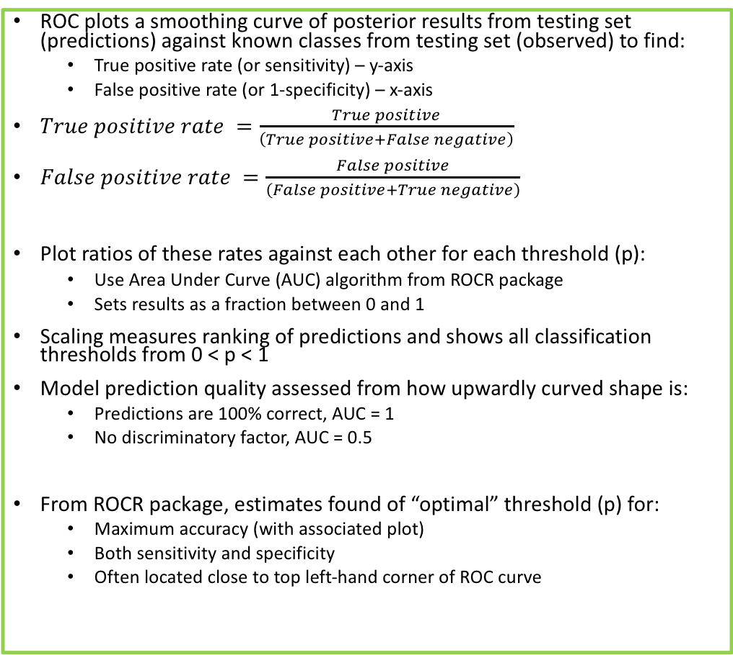
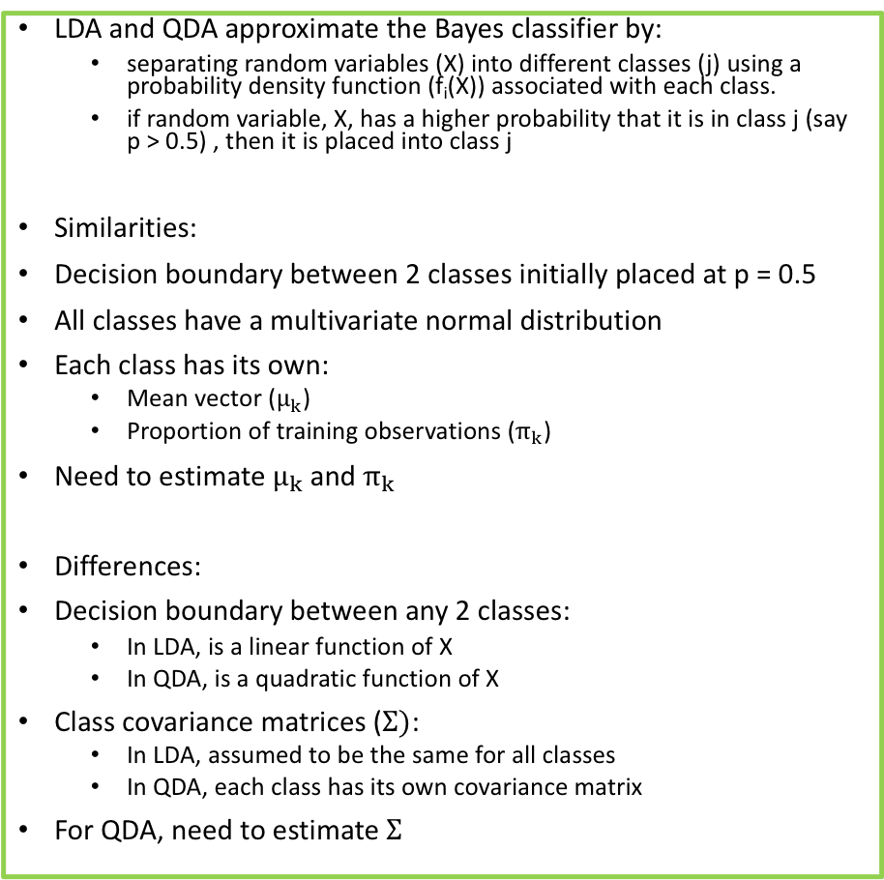
Linear and Quadratic Discriminant Analyses (LDA & QDA) and optimisation using Receiver-Operator curves (ROC)
LDA and QDA approximate the Bayes classifier by:
separating random variables (X) into different classes (j) using a probability density function (f_{i}(X)) associated with each class.
if random variable, X, has a higher probability that it is in class j (say p > 0.5) , then it is placed into class j
Similarities:
Decision boundary between 2 classes initially placed at p = 0.5
All classes have a multivariate normal distribution
Each class has its own:
Mean vector ($μ_{k}$)
Proportion of training observations ($π_{k}$)
Need to estimate $μ_{k}$ and $π_{k}$
Differences:
Decision boundary between any 2 classes:
In LDA, is a linear function of X
In QDA, is a quadratic function of X
Class covariance matrices ($Σ)$:
In LDA, assumed to be the same for all classes
In QDA, each class has its own covariance matrix
For QDA, need to estimate $Σ$
ROC plots a smoothing curve of posterior results from testing set (predictions) against known classes from testing set (observed) to find:
True positive rate (or sensitivity) – y-axis
False positive rate (or 1-specificity) – x-axis
$True positive rate =\frac{True positive}{\left(True positive+False negative\right)}$
$False positive rate =\frac{False positive}{\left(False positive+True negative\right)}$
Plot ratios of these rates against each other for each threshold (p):
Use Area Under Curve (AUC) algorithm from ROCR package
Sets results as a fraction between 0 and 1
Scaling measures ranking of predictions and shows all classification thresholds from 0 < p < 1
Model prediction quality assessed from how upwardly curved shape is:
Predictions are 100% correct, AUC = 1
No discriminatory factor, AUC = 0.5
From ROCR package, estimates found of “optimal” threshold (p) for:
Maximum accuracy (with associated plot)
Both sensitivity and specificity
Often located close to top left-hand corner of ROC curve

Slide 3
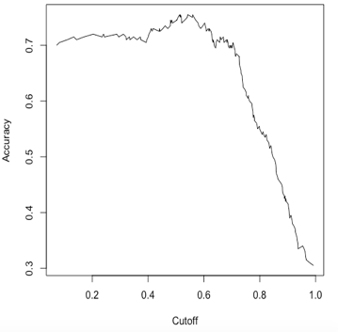
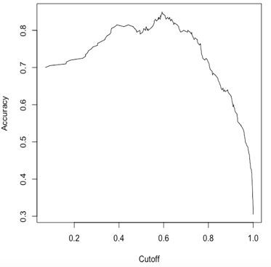


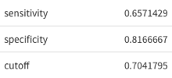

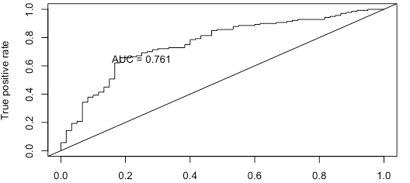
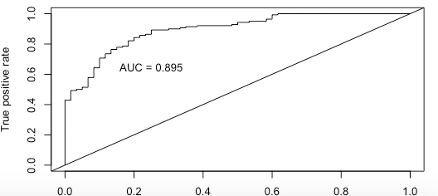
LDA results
QDA results

Slide 4
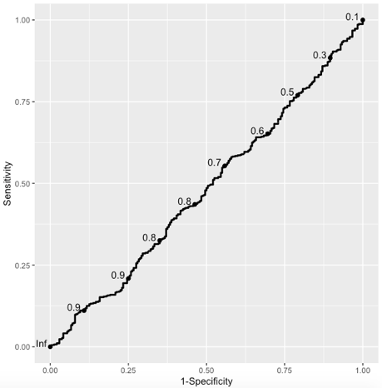



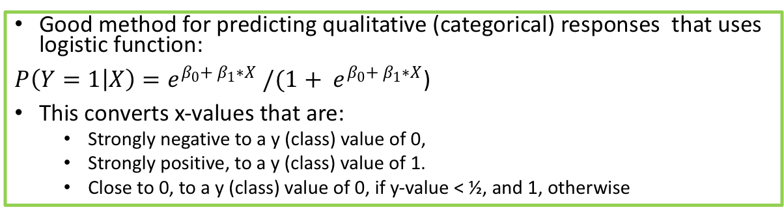
Logistic Regression and Confusion matrices
Good method for predicting qualitative (categorical) responses that uses logistic function:
$P\left(Y=1 | X\right)=e^{β_{0}+ β_{1}∗X} /(1+ e^{β_{0}+ β_{1}∗X}$)
This converts x-values that are:
Strongly negative to a y (class) value of 0,
Strongly positive, to a y (class) value of 1.
Close to 0, to a y (class) value of 0, if y-value < ½, and 1, otherwise
Confusion matrix is an additional optimisation technique, employed with:
K-nearest neighbours (KNN),
Support vector machines (SVM)
Logistic regression
Runs an algorithm that measures accuracy, sensitivity, specificity, etc., between a set of predictions and the testing set:
With classification, these are class value predictions from the testing set and the observed classes in the testing set.
Results easily compared between different classification methods to assess which method as the ”optimal” statistics
Confusion matrix shows results of how well predictions and observations match, so if 0 = True and 1 = False in matrix:
True positive (top left-hand corner: Observation = 0; Prediction = 0)
False negative (bottom left-hand corner: Observation = 0; Prediction = 1)
False positive (top right-hand corner: Observation = 1; Prediction = 0)
True negative (bottom right-hand corner: Observation = 1; Prediction = 1)

Slide 5
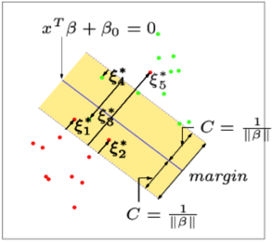
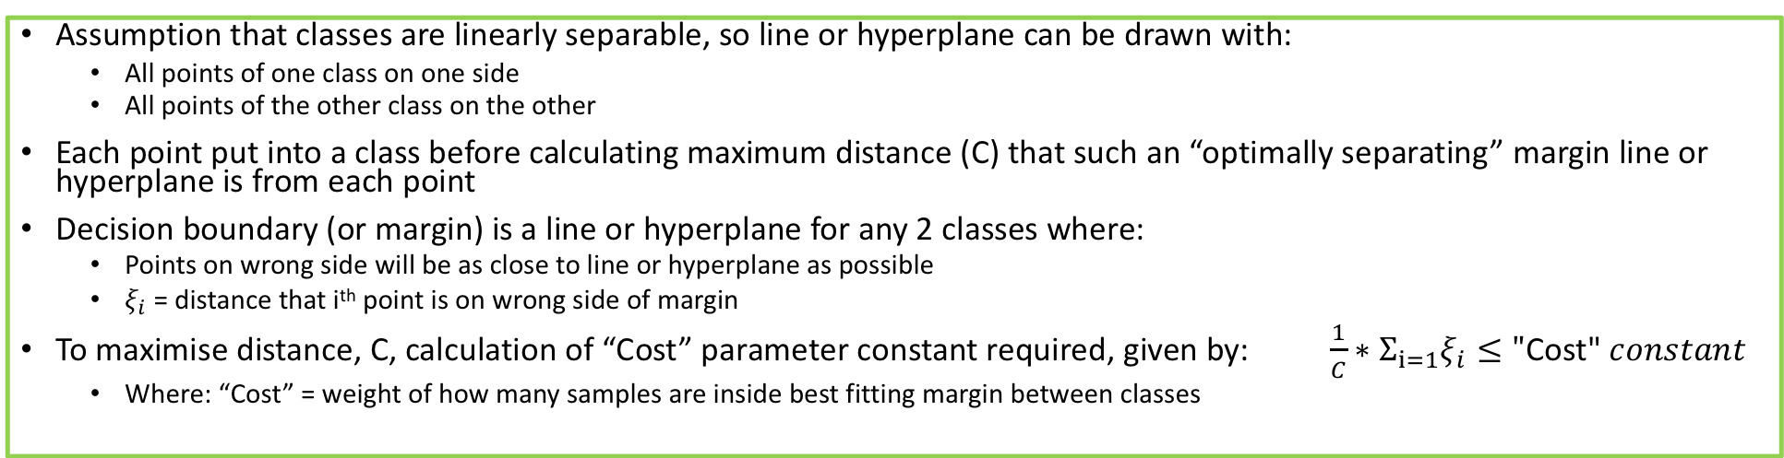
Support vector machines (SVM) and optimisation via Kernel transformation
Assumption that classes are linearly separable, so line or hyperplane can be drawn with:
All points of one class on one side
All points of the other class on the other
Each point put into a class before calculating maximum distance (C) that such an “optimally separating” margin line or hyperplane is from each point
Decision boundary (or margin) is a line or hyperplane for any 2 classes where:
Points on wrong side will be as close to line or hyperplane as possible
$ξ_{i}$ = distance that i^{th} point is on wrong side of margin
To maximise distance, C, calculation of “Cost” parameter constant required, given by: $\frac{1}{C}∗Σ_{i=1}ξ_{i}≤"\text{Cost}\text{" }constant$
Where: “Cost” = weight of how many samples are inside best fitting margin between classes
“Cost” function optimised by transformations using different SVM Kernel functions:
Linear (Kernels create linear hyperplanes)
Radial (Kernels create circular hyperplanes)
Polynomial (Kernels create hyperplanes with quadratic and higher terms)
Latter 2 techniques used in non-linear scenarios with SVM Kernel functions that
transform complex point arrangements
places them into classes using predefined labels
“Optimal cost” shown in plots of accuracy vs. “Cost” for each SVM technique

Slide 6









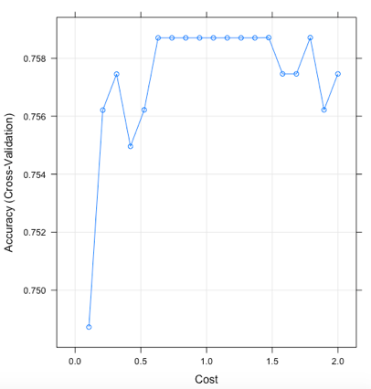
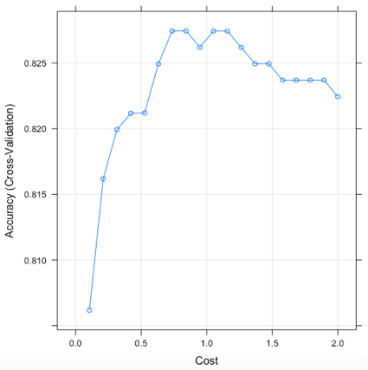
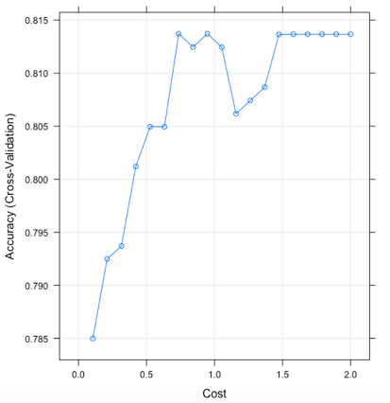
Linear SVM
Radial SVM
Polynomial SVM

Slide 7

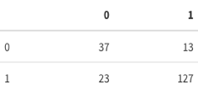

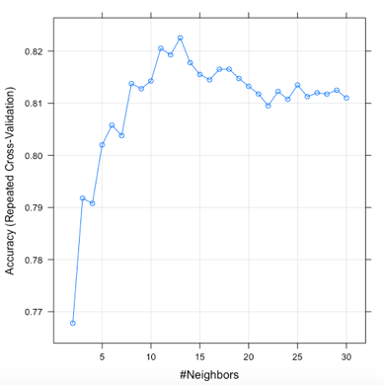
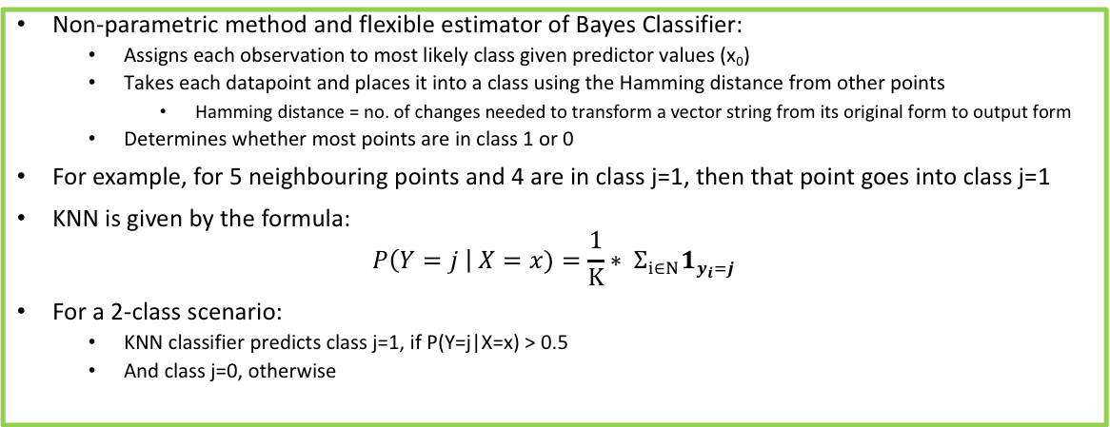
K-Nearest Neighbours (KNN) and k-folds cross-validation
Non-parametric method and flexible estimator of Bayes Classifier:
Assigns each observation to most likely class given predictor values (x₀)
Takes each datapoint and places it into a class using the Hamming distance from other points
Hamming distance = no. of changes needed to transform a vector string from its original form to output form
Determines whether most points are in class 1 or 0
For example, for 5 neighbouring points and 4 are in class j=1, then that point goes into class j=1
KNN is given by the formula:
$$P\left(Y=j \right| X=x)=\frac{1}{K}∗ Σ_{i∈N}1_{y_{i}=j}$$
For a 2-class scenario:
KNN classifier predicts class j=1, if P(Y=j|X=x) > 0.5
And class j=0, otherwise
Fitting KNN model requires dealing with trade-off between:
Over-fitting model to training dataset (with poor fit to test dataset)
Having too simple a model that doesn’t capture variance in datasets
Cross-validation assesses trade-off by:
Training model on a large dataset (training set)
Finding “optimal” solution by validation on a small test dataset (testing set)
Cross-validation method used is k-folds cross-validation:
Cut training dataset into equally sized k-portions (start at k=3)
Remove 1 portion to be used later
Test model on remaining (k-1) portions
Validate this model on removed portion
Repeat by removing each portion in turn until all portions are tested
Process repeats for different k-values (i.e. 4, 5, etc.) up to a limit to find “optimal” k-value with highest accuracy
K-value has “optimal” trade-off between bias (for lower k-values) and variance (for higher k-values)
“Optimal” k-value shown in a plot of accuracy vs. no. of neighbours
Optimal k-value = 13

Slide 8
Conclusions
Dataset trained and tested using:
Linear Discrimination analysis (with ROC optimization)
Quadratic Discrimination analysis (with ROC optimization)
Logistic regression (with ROC optimization and confusion matrix)
Support vector analysis (with Linear, Radial and Polynomial Kernel transformation optimization and confusion matrix)
K-nearest neighbours (with k-folds cross-validation and confusion matrix)
“Optimal” method is QDA
Highest accuracy (85%)
Highest relative combinations of sensitivity (~84%) and specificity (80%)

